Slide 1


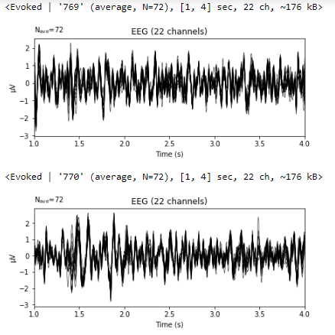
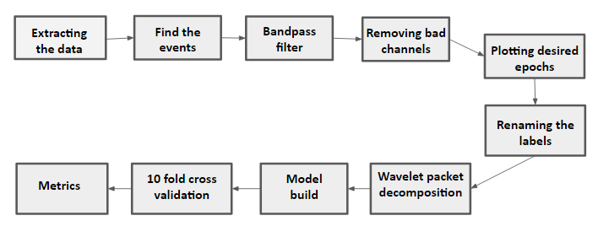
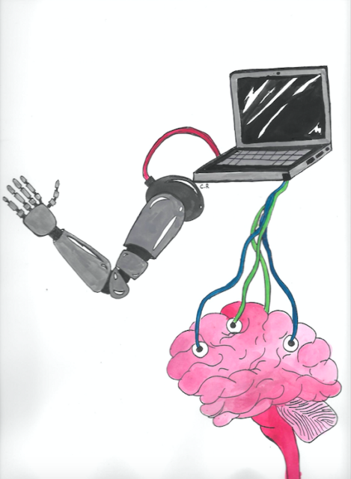
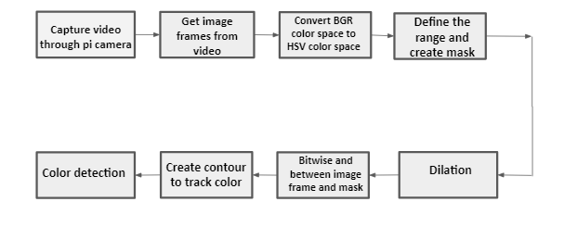
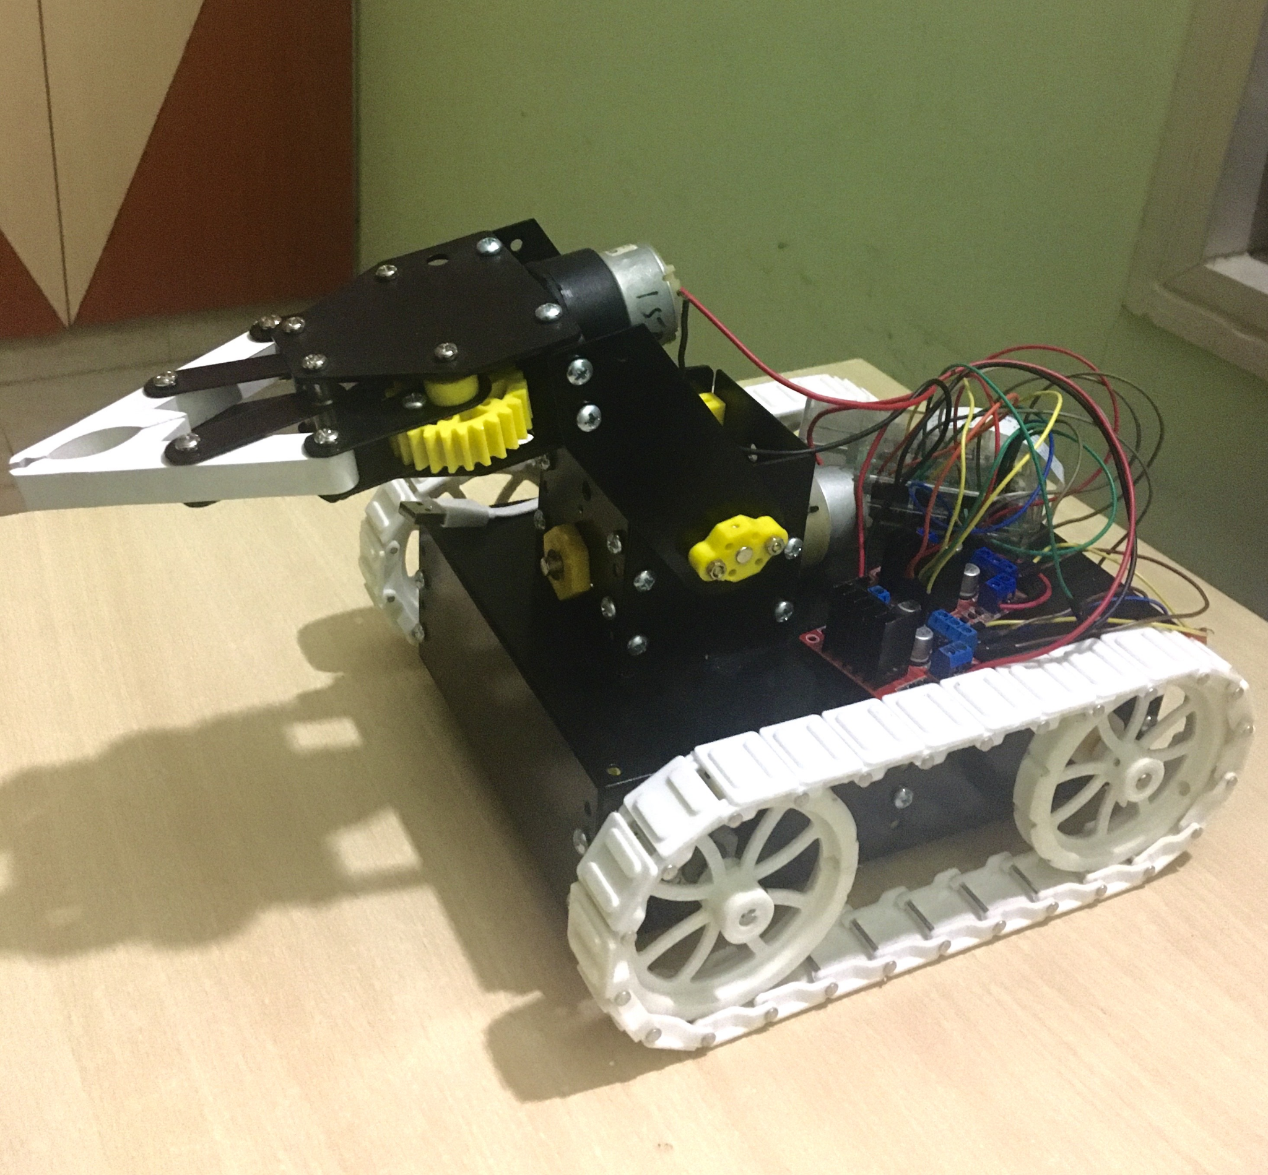
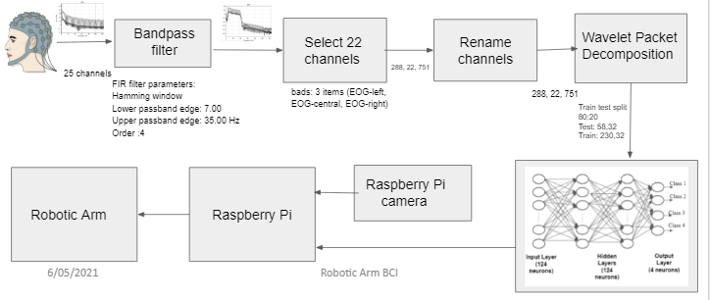
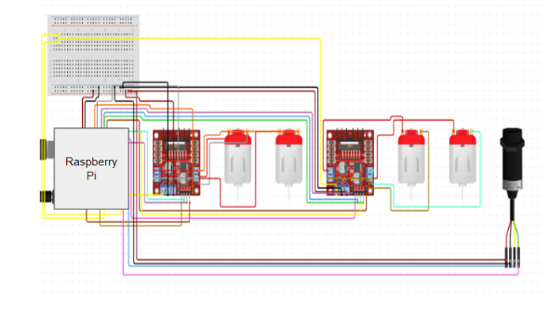
BCI FOR CONTROLLING ROBOTIC ARM
Shreya V Deexit, V Saisri, Harshita R Vastrad
Project Guide: Dr. B. Niranjana Krupa & Prof. Sweta. G
Abstract
Theory
Workflow
Results and Conclusion
Brain Computer Interface (BCI) refers to the interaction of the central nervous system or the brain with a computer where the signals generated by the brain due to external stimulus are used to control an external device. The electroencephalographic (EEG) signal obtained by the imagination of movements of hands and legs is being used in our project. The EEG signal is susceptible to external noise and hence filtering out the perturbations and from the actual EEG data classifying it and building a system is the challenge.
EEG-The electroencephalogram is a scalp recording of the brain's electrical activity.These signals are generally categorized as delta, theta, alpha, beta and gamma based on signal frequencies ranges from 0.1 Hz to more than 100 Hz.
Analysis of EEG signals to generate control command.
This project can be used for people with disabilities, as well as those who do not have a physical body. They can monitor their missing body parts with the help of their brain . The benefit is that they can develop their mental and attention skills.By changing model parameters such as the optimizer, dropout value, and number of layers, as well as adding early stopping to minimise overfitting and L2 regularisation. By comparing the accuracies of all the variants, we can conclude that the Rmsprop optimizer, dropout of 0.5, 2 hidden Layers, early stopping, and L2 regularisation generated the best average accuracy of 71.03 percent.
Motor Imagery-One of the standard concepts of BCI is brain computer interface based on motor imagery (MI). In MI, the user can produce induced activity from the motor cortex of the brain by imagining motor movements without any hand movement or external stimulus.
Wavelet Packet Decomposition: The Discrete Wavelet Transform (DWT) is a multi-resolution time-frequency study of signals. DWT is preferred over Fourier Transform because it has frequency resolution as well as temporal resolution information, which is why it is called a time-frequency analysis.
In this project we have done the analysis of the EEG signal to generate control command by getting noise free preprocessed EEG signal, feature extraction and passing it through the ANN model. The control commands are given to the robotic arm which picks and drops the objects using directions and object detection.
2. Object detection
This is the robotic Arm used in the Project. Based on th control command received it moves in that particular direction, identifies the object and picks and drops the object
Implementation
The EEG signal is extracted from the dataset, pre-processing is done by passing the signal through bandpass filter, selecting desirable channels and renaming channels. We split the EEG signal into sub-bands such as Delta (0.5 to 4 Hz), Theta (4 to 8 Hz), Alpha (8 to 16 Hz), Beta (16 to 32 Hz), and Gamma ( >32 Hz) to analyse it. On the pre-processed EEG signals, a two-level Discrete Wavelet Transform with ‘db4’ as mother wavelet is applied, yielding three groups of comprehensive coefficients d3, d4 and d5 from the signal..8 frequency band coefficients are chosen from the range 4-32HzArtificial neural networks architecture is used to classify the extracted features from the EEG signals into four groups. The model is made up of four layers.1 input layer, 2 hidden layers and 1 output layer. Drop out of 0.5, L2 regularizer and rmsprop optimizer is used , 80% of the total data was used for training the model and the remaining 20% was used for testing.. Also the early stopping was implemented such that training loss never goes below validation loss.
The model weights are saved and sent to the raspbian os. We loaded the model on raspberry pi, the model classifies the input given to it and provides us the class number using which raspberry pi controls the direction of robotic arm. To pick and drop the object we are using object detection. Robotic Arm contains four DC motors, two motors to control forward, backward, right, left movements and the other two are to control the arm in order to facilitate the pick and drop actions. H-bridge is used to control the speed of the motors.
Block Diagram
Circuit Diagram of the Robotic Arm

